Slide 1
Big Data Analytics and Mining
Junming Shao

Slide 2
Lecture Six
Graph Mining

Slide 3
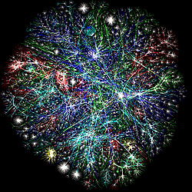
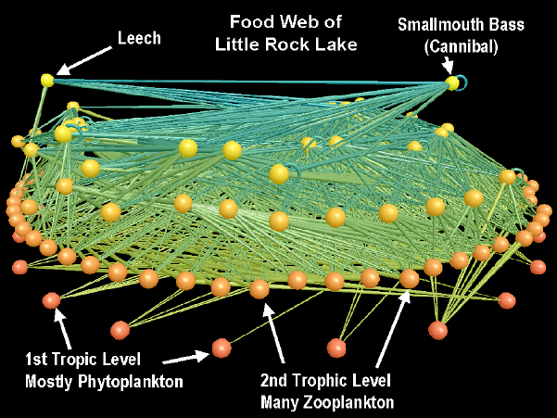
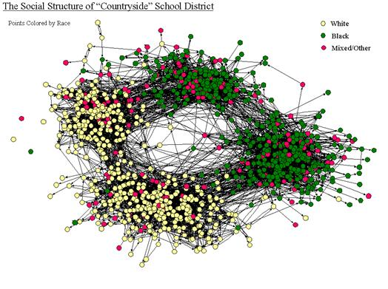
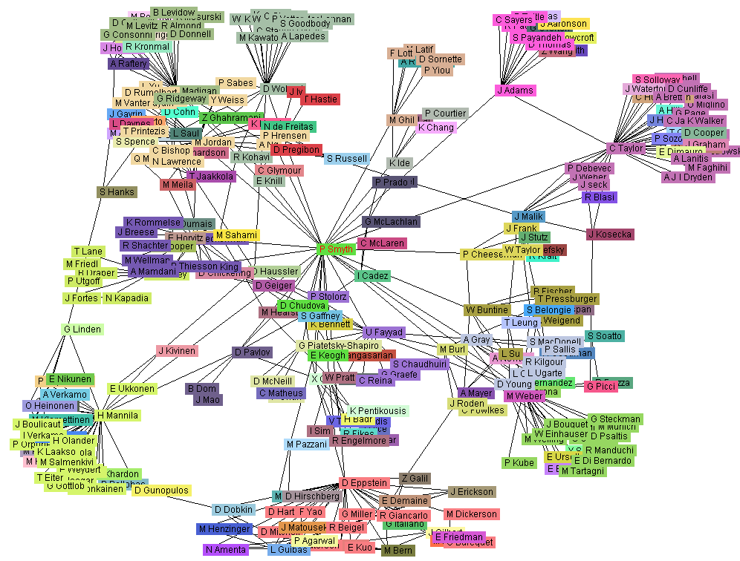
Background
Networks/Graphs -- exist everywhere.
Internet
Food Web
Friendship Network
Co-author networks

Slide 4

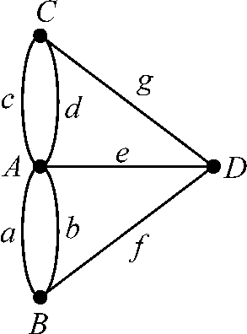
Background
Origin of Graph Theory:
Seven Bridges of Königsberg (proposed by Leonhard Euler(欧拉))
--wiki
The city of Königsberg in Prussia (now Kaliningrad, Russia) was set on both sides of the Pregel River, and included two large islands which were connected to each other, or to the two mainland portions of the city, by seven bridges. The problem was to devise a walk through the city that would cross each of those bridges once and only once.

Slide 5
Network/Graph – construct
Data Instance
Graph Instance
Element
Vertex
Element’s Attributes
Vertex Label
Relation Between
Two Elements
Edge
Type Of Relation
Edge Label
Relation between a Set of Elements
Hyper Edge
Provide enormous flexibility for modeling the underlying data as they allow the modeler to decide on what the elements should be and the type of relations to be modeled

Slide 6
Networks/Graphs – applications in real-world?
Information Maximization
‘viral’ marketing.
Web-log (‘blog’) news propagation.
Computer network security
Email/IP traffic and anomaly detection
Prediction
The prediction of flow within networks

Slide 7
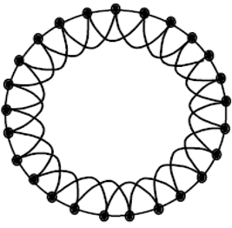
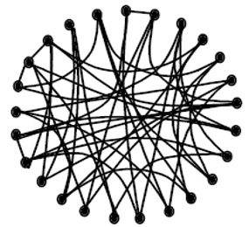
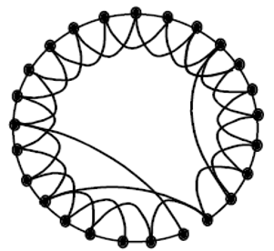
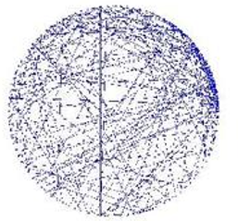
Networks types:
REGULAR
RANDOM
SMALL WORLD
SCALE-FREE
1950s,Erdos and Renyi
1998,Watts and Strogatz
1999,Barabasi and Albert
T

Slide 8
Small world network:
Six degree of separation
The average distance between two randomly individuals in the USA : 6
The average distance between two randomly users in Facebook(721 million active users, 69 billion links ) : 4.74
…

Slide 9
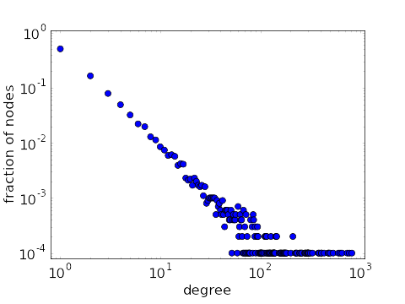
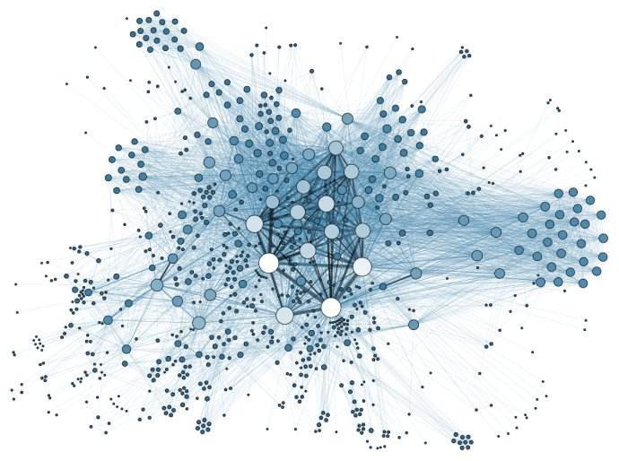
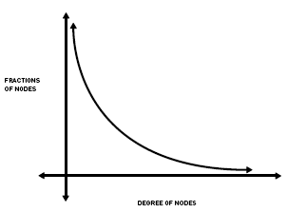
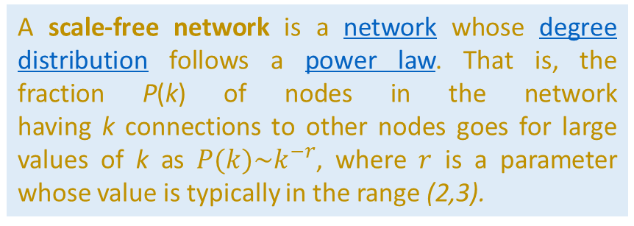
Scale-Free networks:
Degree distribution
Social network
A scale-free network is a network whose degree distribution follows a power law. That is, the fraction P(k) of nodes in the network having k connections to other nodes goes for large values of k as $P(k)\sim k^{−r}$, where $r$ is a parameter whose value is typically in the range (2,3).
Power law

Slide 10
Key Node Identification

Slide 11
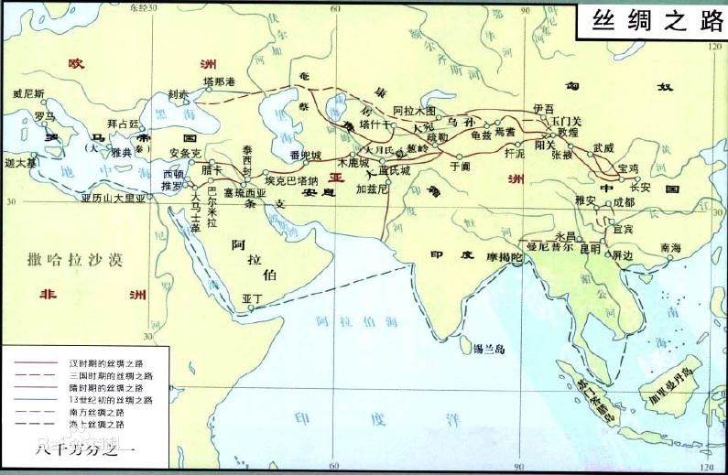
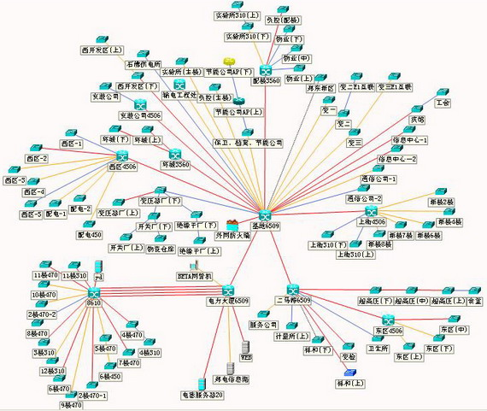
Background
Key Node Identification
How should we select some special customers to viral market efficiently if we have a limited budget?
Which countries have a huge impact on the global trade?
Who hold great power on the terrorist organization?
Which node is the weakest position in the power supply network?

Slide 12
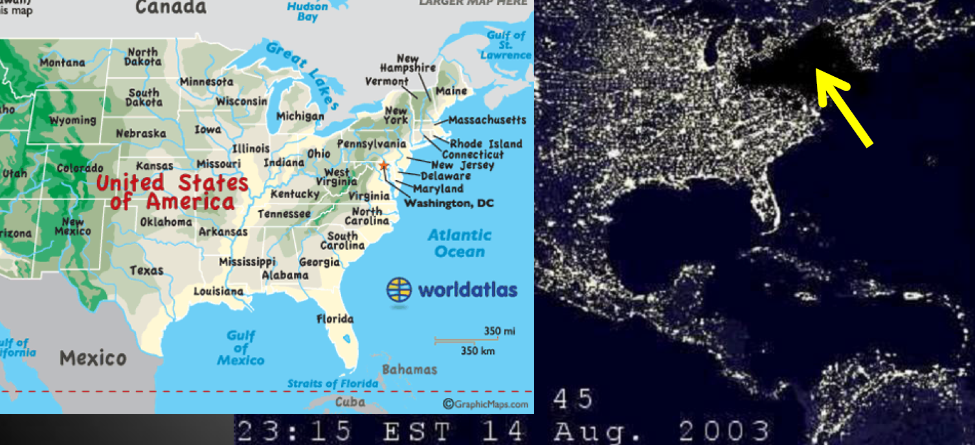
Key Node Identification
It powered cut on a large scale in America.

Slide 13
Key Node Identification
Which key electronic stations do we protect to avoid all electronic network shut down when some electronic stations damage ?

Slide 14
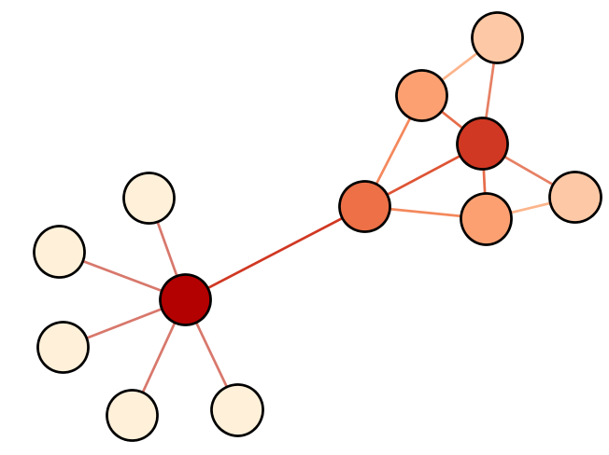
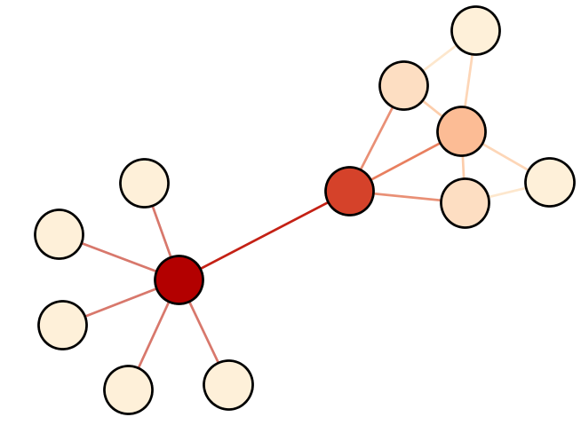
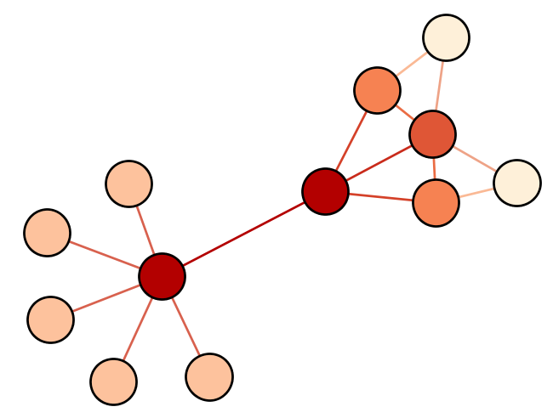
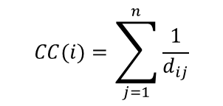
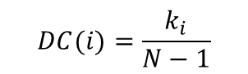
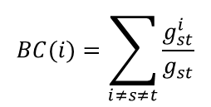
Strategy ONE: Centrality
Degree Centrality:
The size of connections is used to measure node importance(the node’s direct influence).
Betweenness Centrality:
The betweenness centrality for each vertex is the number of these shortest paths that pass through the vertex.
Closeness Centrality:
To calculate as the sum of the length of the shortest paths between the node and all other nodes in the graph.
$$DC(i)=\frac{k_{i}}{N−1}$$
$$BC(i)=\sum_{i≠s≠t}{\frac{g_{st}^{i}}{g_{st}}}$$
$$CC(i)=\sum_{j=1}^{n}{\frac{1}{d_{ij}}}$$
Notes:
$k_{i}$: the number of neighbors
$g_{st}$: the number of the shortest paths from node s to node t.
$g_{st}^{i}$: the number of the shortest paths from node s to node t and pass node i.

Slide 15
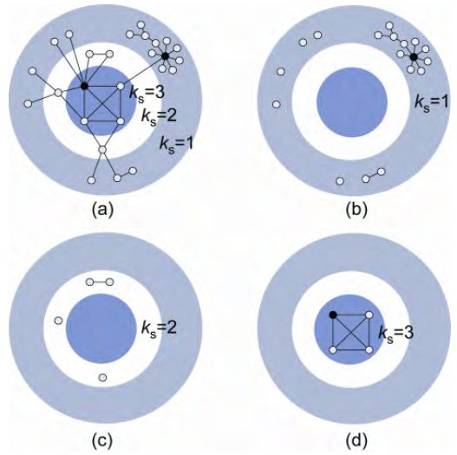
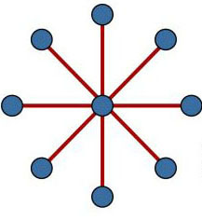
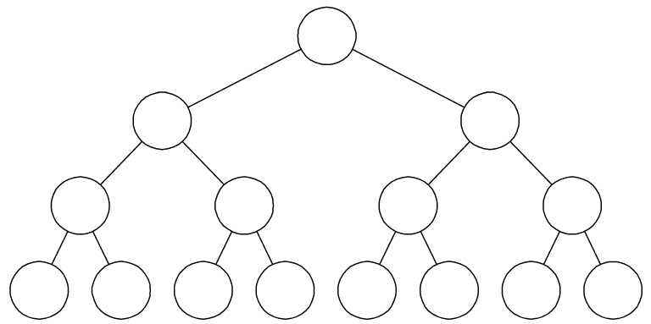
Algorithms
Strategy TWO: K-shell Decomposition
Layer or shell.
More central, more influential.
Advantage:
Low computational complexity.
Reveal the hierarchy structure clearly.
Disadvantage:
Can’t be used in quite a lot networks, such as the star network, tree and so on.
Too coarse, some times is inferior to degree measure.

Slide 16
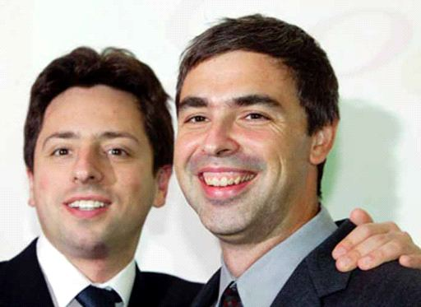

Algorithms
Strategy THREE: Eigenvector, e.g. PageRank
The core of Google’s early search engine.
Sergey Brin and Larry Page’s paper “The PageRank citation ranking: Bringing order to the Web” at WWW98(World Wide Web conference98) made small ripples in the information science community that quickly turned into waves.

Slide 17
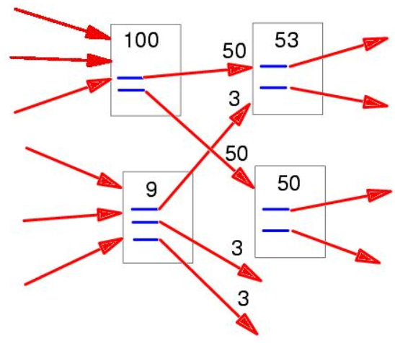

Algorithms
Basic Idea
If a page is linked with many high-cited pages
Then it will gain high PageRank score!

Slide 18
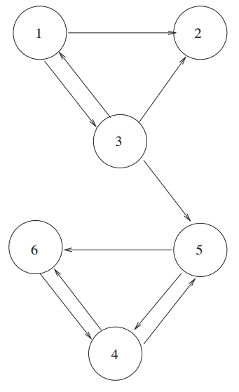
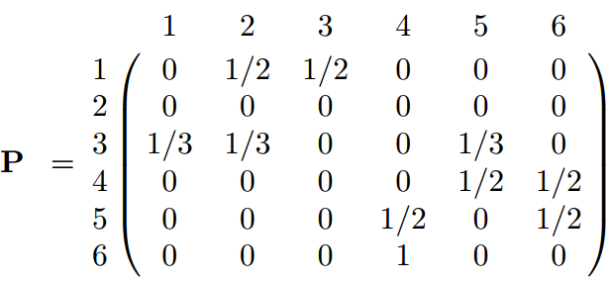
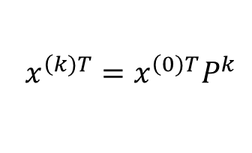
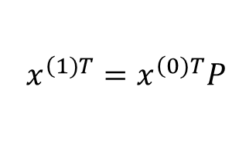
Algorithms
Page Rank
Markov Matrix ：
node 2 (Dangling Node) has no outlinks!
$$x^{\left(1)T\right.}=x^{\left(0)T\right.}P$$
$$x^{\left(k)T\right.}=x^{\left(0)T\right.}P^{k}$$

Slide 19
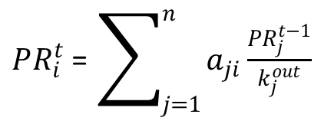
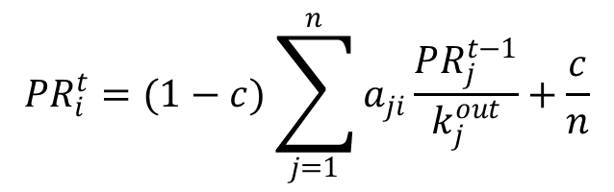
Algorithms
Page Rank
Basic iteration function ：
Another Interpretation for Random jump ：
$PR_{i}^{t}$ = $\sum_{j=1}^{n}{a_{ji}\frac{PR_{j}^{t−1}}{k_{j}^{out}}}$
Even though the customer always browses webpages by hyperlinks, but he can also use URL to “teleport” to a new page.
However, the Dangling Node will “absorb” all the PR !!
Random jump ：
$$PR_{i}^{t}=(1−c)\sum_{j=1}^{n}{a_{ji}\frac{PR_{j}^{t−1}}{k_{j}^{out}}}+\frac{c}{n}$$
Notes:
为什么最大特征值为1？
1.为啥一定有1这个特征值：只需证明对应的|P-I|一定等于0即可
2.为啥1是最大特征值(一种定性的解释)：如果最大特征值大于1，那么P的多次幂就会不断增长，这样就不能保证每个元素非负情况下，每一行/列相加还要等于1(因为特征值对矩阵的幂有一种“缩放”功效，如果大于1，那么就是放大的

Slide 20
Community Detection

Slide 21
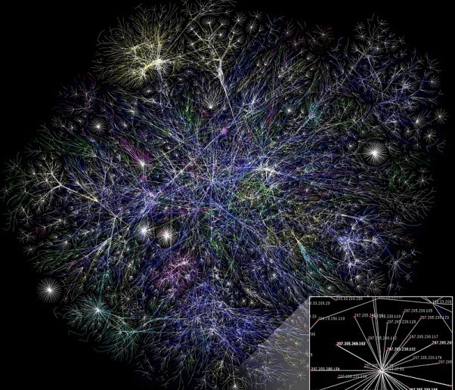
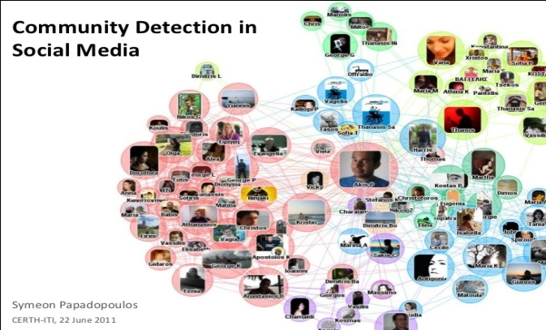
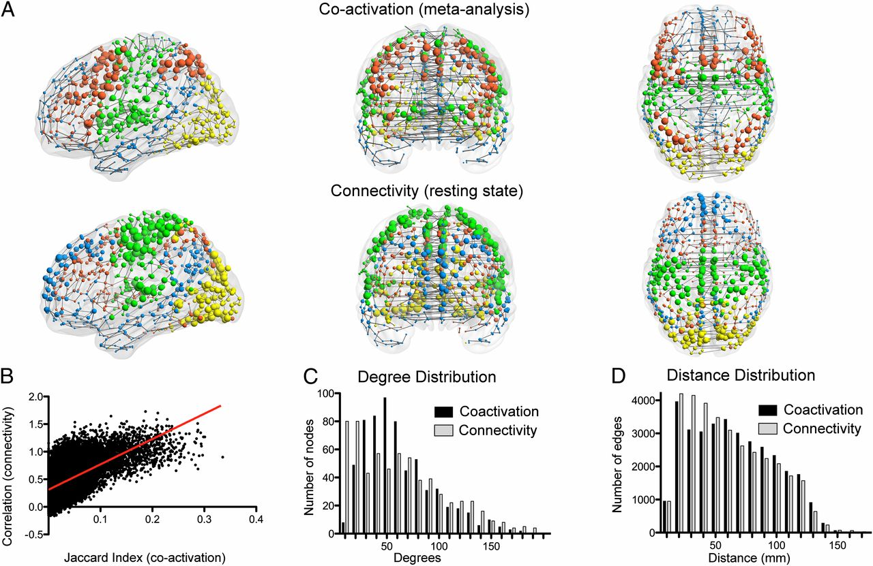
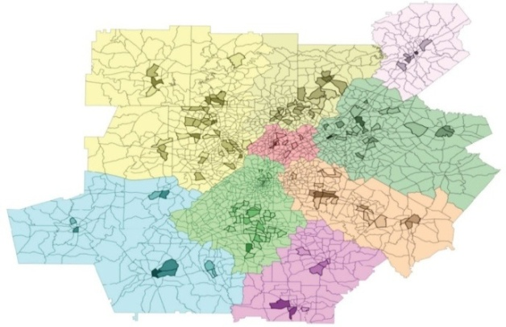
Community Detection
Community structure: Common Characteristic in networks
Social Networks: Papadopoulos etc.Data Mining and Knowledge Discovery, 2012, 24(3): 515-554.
Web Networks: From Wikipedia
Brain Networks: Crossley et al., De Leo V, etc. PNAS, 2012.
Transportation networks: Szell etc. Scientific reports, 2012, 2.

Slide 22
Community Detection
How can we find intrinsic community structure in large-scale networks?
Existing Works
Minimum Cut (IEEE TPAMI’93)
Normalized cut (IEEE TPAMI’96)
Modularity (PNAS’02, PNAS’06, JSM’08)
Random Walk (PNAS’08)
Multi-level Clustering (SIAM JSC’98, JPDC’98)
Dynamic Community Detection (KDD’15)

Slide 23
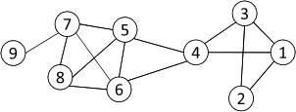
Strategy ONE: Cut-based Methods
1、Minimum Cut
Most interactions are within group whereas interactions between groups are few
community detection → minimum cut problem
Cut: A partition of vertices of a graph into two disjoint sets
Minimum cut problem: find a graph partition such that the number of edges between the two sets is minimized

Slide 24
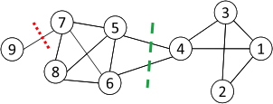
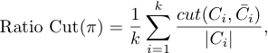
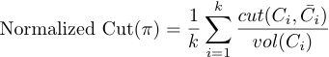
2、Ratio Cut & Normalized Cut
Strategy ONE: Cut-based Methods
Minimum cut often returns an imbalanced partition, with one set being a singleton, e.g. node 9
Change the objective function to consider community size
C_{i,}: a community
|C_{i}|: number of nodes in C_{i}
vol(C_{i}): sum of degrees in C_{i}

Slide 25
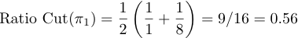
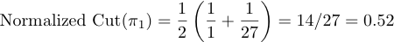
Example
For partition in red:
For partition in green:
Both ratio cut and normalized cut prefer a balanced partition

Slide 26
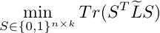
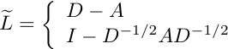
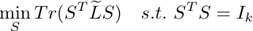
Cut-problem to Spectral Clustering
Both ratio cut and normalized cut can be reformulated as
Where
Spectral relaxation:
Optimal solution: top eigenvectors with the smallest eigenvalues
graph Laplacian for ratio cut
normalized graph Laplacian
A diagonal matrix of degrees
https://www.cs.cmu.edu/~aarti/Class/10701/readings/Luxburg06_TR.pdf

Slide 27
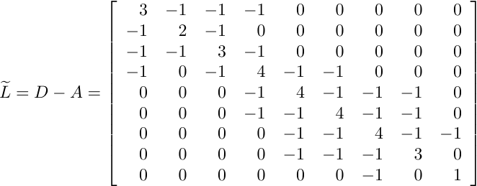
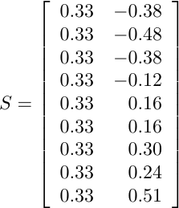
Example
Two communities:
{1, 2, 3, 4} and {5, 6, 7, 8, 9}
The 1st eigenvector means all nodes belong to the same cluster, no use
k-means
Centered matrix
Notes:
The 1st eigenvector is discarded
27

Slide 28
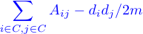
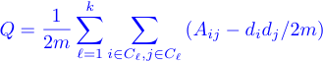
3、Modularity Maximization
Strategy ONE: Cut-based Methods
Modularity measures the strength of a community partition by taking into account the degree distribution
Given a network with m edges, the expected number of edges between two nodes with degrees d_{i} and d_{j} is
Strength of a community:
Modularity:
A larger value indicates a good community structure
The expected number of edges between nodes 1 and 2 is
3*2/ (2*14) = 3/14

Slide 29

Modularity Matrix
Centered matrix
Modularity matrix:
Similar to spectral clustering, Modularity maximization can be reformulated as
Optimal solution: top eigenvectors of the modularity matrix
Apply k-means to S as a post-processing step to obtain community partition
29

Slide 30


Example
Two Communities:
{1, 2, 3, 4} and {5, 6, 7, 8, 9}
k-means
Modularity Matrix
30

Slide 31

Distance Dynamics
Distance Dynamics - A New Viewpoint For Community Detection
BASIC IDEA: Simulate the change of edge distances
View network as dynamical system (Dynamic vs. Static)
Simulate the distance dynamics based on different interaction patterns (Distance dynamics vs. Node dynamics)
All edge distances will converge, and the community structure is intuitively identified.
For example:
Initial State — Intermediate State — Steady State

Slide 32

How to define the interaction patterns?
Assumption: If two nodes are linked, each node attracts the other and makes the opposite node move to itself.
Edge Distance: Influenced by three different types of nodes: (a) Direct linked nodes; (b) Common neighbors; (c) Exclusive neighbors
Common neighbours
Direct
Exclusive neighbours

Slide 33

Three Interaction Patterns
x
Influence from Direct Linked Nodes: makes u and v closer.
Influence from Common neighbors: make u and v closer.
Influence from Exclusive neighbors: make u and v closer OR farther.

Slide 34






Interaction model
x

Slide 35

Community Detection：Simulating Distance Dynamics
P1: Initialization
P2: Dynamics
P3: Community Detection
Compute Jaccard distance for each edge
Investigate the change of distance of each edge
Cut off the edges with distance of 1

Slide 36
Parameterization: cohesion parameter λ
Cohesion parameter λ
Large λ produces small-size communities and small λ yields large-size communities.
Experiments demonstrate Attractor can achieve stable high-quality result when cohesion parameter λ is within [0.4 0.6].

Slide 37


Evaluation – comparison on synthetic data
noise
density

Slide 38


Evaluation – comparison on real data
Labeled networks
Unlabeled networks

Slide 39
Graph Embedding

Slide 40

Motivation
Networks contain billions of nodes and edges, which is intractable to perform complex inference on the entire network
Machine learning algorithms need vector representation
How to preserve community structure during graph embedding?
How to process large-scale networks efficiently?

Slide 41


Motivation
The goal of graph embeddings is to map each node into a low-dimensional space.
Graph (non-Euclidean) properties:
Node numbering is arbitrary
Graphs has arbitrary size
More complex structure
Challenges:
Measure the similarity between nodes
Encode network information and generate node representation

Slide 42

Deep Learning Method
Deep Walk
Basically it is a combination of sampling on the graph by random walk + word2vec
Random walk:

Slide 43
Deep Learning Method
Deep Walk
Basically it is a combination of sampling on the graph by random walk + word2vec
word2vec:

Slide 44

Deep Learning Method

Slide 45

Deep Learning Method

Slide 46

Deep Learning Method

Slide 47

Deep Learning Method

Slide 48

Deep Learning Method

Slide 49

Deep Learning Method

Slide 50


Deep Learning Method

Slide 51


Node2vec: unsupervised features learning
Intuition: Find embedding of nodes to d-dimensions that preserves similarity.
Idea: Learn node embedding such that nearby nodes are close together.
Given a node u, how do we define nearby nodes? (N_{s}(u): neighbourhood of 𝑢 obtained by some strategy S)
Given G=(V,E)
Goal is to learn: f: u→ℝ$d$
Given node u, we want to learn feature representation f(u) that is predictive of nodes in u’s neighborhood N_{s}(u).
node2vec: Scalable Feature Learning for Networks. A. Grover, J. Leskovec. KDD 2016

Slide 52


Node2vec: unsupervised features learning
Goal: Find embedding f(u) that predicts nearby nodes N_{s}(u)
Assume conditional likelihood factorizes:
Then softmax:
Estimate f(𝑢) using stochastic gradient descent.
How to determine N_{s}(u)?

Slide 53



Node2vec: unsupervised features learning
How to determine N_{s}(u)?
Local microscopic view
Global macroscopic view

Slide 54
Node2vec: unsupervised features learning
Interpolating BFS and DFS
Biased random walk S that given a node 𝑢 generates neighborhood N_{s}(u)
Two parameters:
Return parameter p:
Return back to the previous node
In-out parameter q:
Moving outwards (DFS) vs. inwards (BFS)
Intuitively, is the “ratio” of BFS vs. DFS

Slide 55


Node2vec: unsupervised features learning
Biased 2nd-order random walks explore network neighborhoods:
Now
Last step
The walk just transitioned from t to v and is now evaluating its next step out of node v. Edge labels indicate search biases α. Where 1/𝑝, 1/q, 1 are
unnormalized probabilities.
BFS-like walk: Low value of p.
DFS-like walk: Low value of q.

Slide 56

Node2vec: unsupervised features learning
Idea: Remember where that walk came from
Node2vec Algorithm
1). Simulate random walks of length l starting from each node 𝑢.
2). Optimize the node2vec objective using Stochastic Gradient Descent.
Advantages
1). Linear-time complexity
2). All 3 steps are individually parallelizable

Slide 57
Thank You

